Slide 1
Progress Update
Enno Belz
07.04.2021

Slide 2
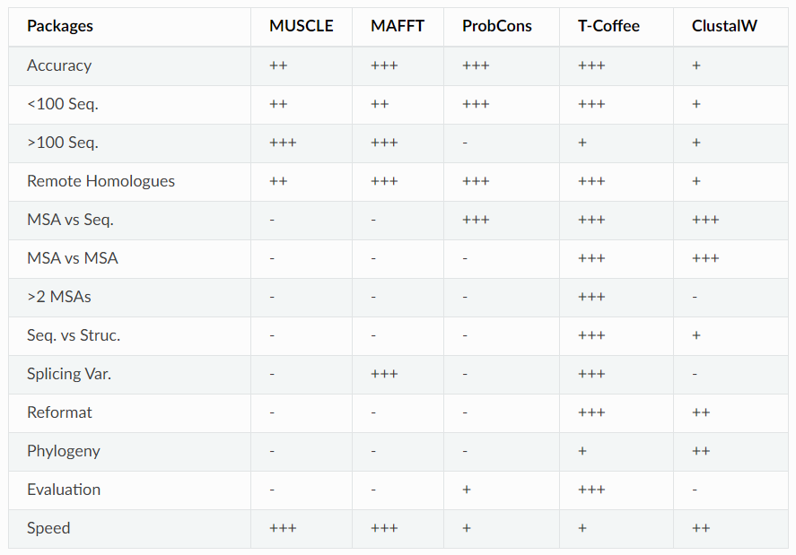
https://tcoffee.readthedocs.io/en/latest/tcoffee_main_documentation.html#the-main-methods-and-their-scope

Slide 3
T-Coffee (Tree Based Consistency Objective Function For Alignment Evaluation)
Erstellt Bibliothek von paarweisen Alignments
Lokal (Lalign, FASTA package) und global (Clustalw)
Bibliothek: Paare von Residues die gewichtet werde
Bib-Einträge werden „addiert“
Daraus guidetree und MSA
Keine (triviale) Ausgabe der Distmatrix
+ Einfach Parameter (GO, GE, SM) zu erstellen
+ Built-In Evaluierung-, Formatierungs- und Filtermethoden

Slide 4
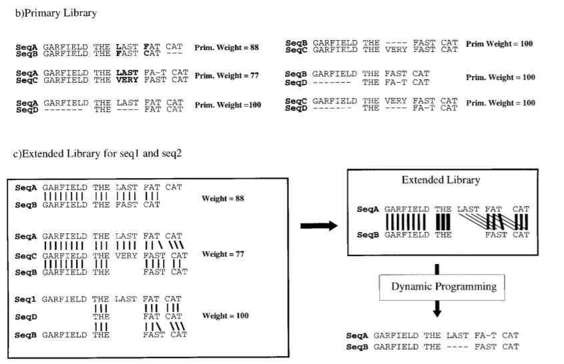
T-Coffee: A Novel Method for Fast and Accurate Multiple Sequence Alignment Cedric Notredame1,2,3 *, Desmond G. Higgins and Jaap Heringa
Notes:
It also has the advantage of great simplicity. Libraries are lists of weighted pair-wise constraints. Each constraint receives a weight equal to percent identity within the pair-wise alignment it comes from (Figure 2(b)). For each set of sequences, two primary libraries are computed along with their weights, one using ClustalW (global alignments; Figure 2(b)) and the second using Lalign (local).

Slide 5
ClustalO
Benutzt mBed: 2 Distanzmetriken: Approximiert Sequenzdistanzen
k-tuple → Vektor
Eukildische Distanz der Vektoren
Guide Tree
Hhalign package: Aligniert 2 HHM Profile
+ distmat_out = file.name
- Parameterwahl nicht über Kommandozeile

Slide 6
Clustalw
Paarweise Alignments → Distanzmatrix
Guide Tree Berechnung
Unrooted NJ tree
Rooted NJ tree
Progressives Alignment
Distmat out nicht über Kommandozeile
+ Am benutzerfreundlichsten

Slide 7
Distance matrix calculation
Using Biopython
def fasta_to_distance_matrix(patient, substitution_matrix, full=False): """ :param full: Boolean, False, calculates only lower triangle matrix, True, calculates full distance matrix. Per default=False. :param patient: FASTA-file :param substitution_matrix: String (e.g. "BLOSUM45", "GONNET1992") Calculates distance matrix from FASTA-file and saves as csv. """
pairwise2.align.globalds(seqA.seq, seqB.seq, matrix, -10, -0.5, score_only=True)
Gapopen, Gapextent

Slide 8
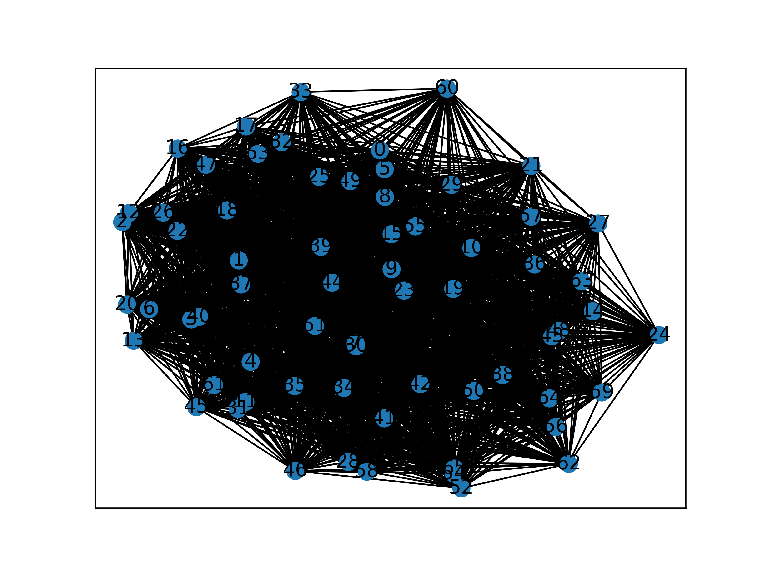
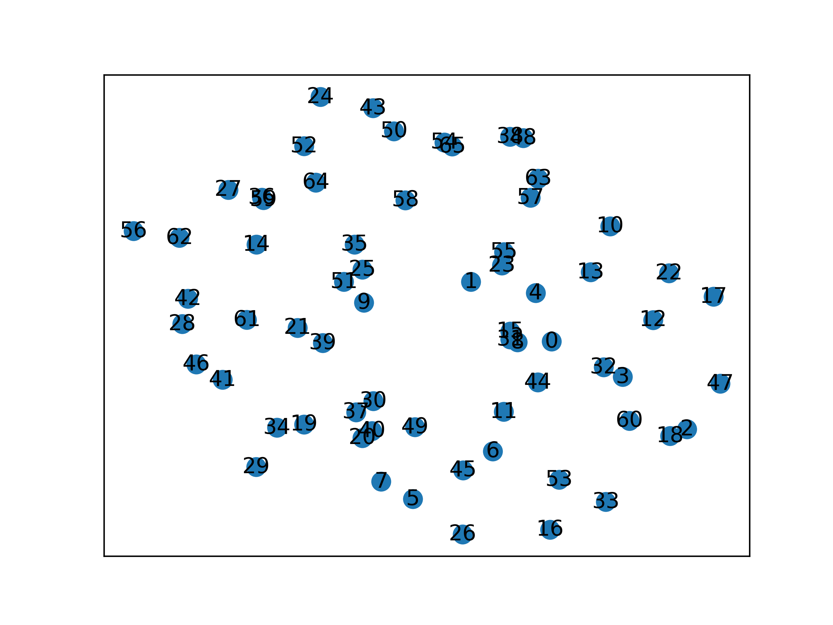
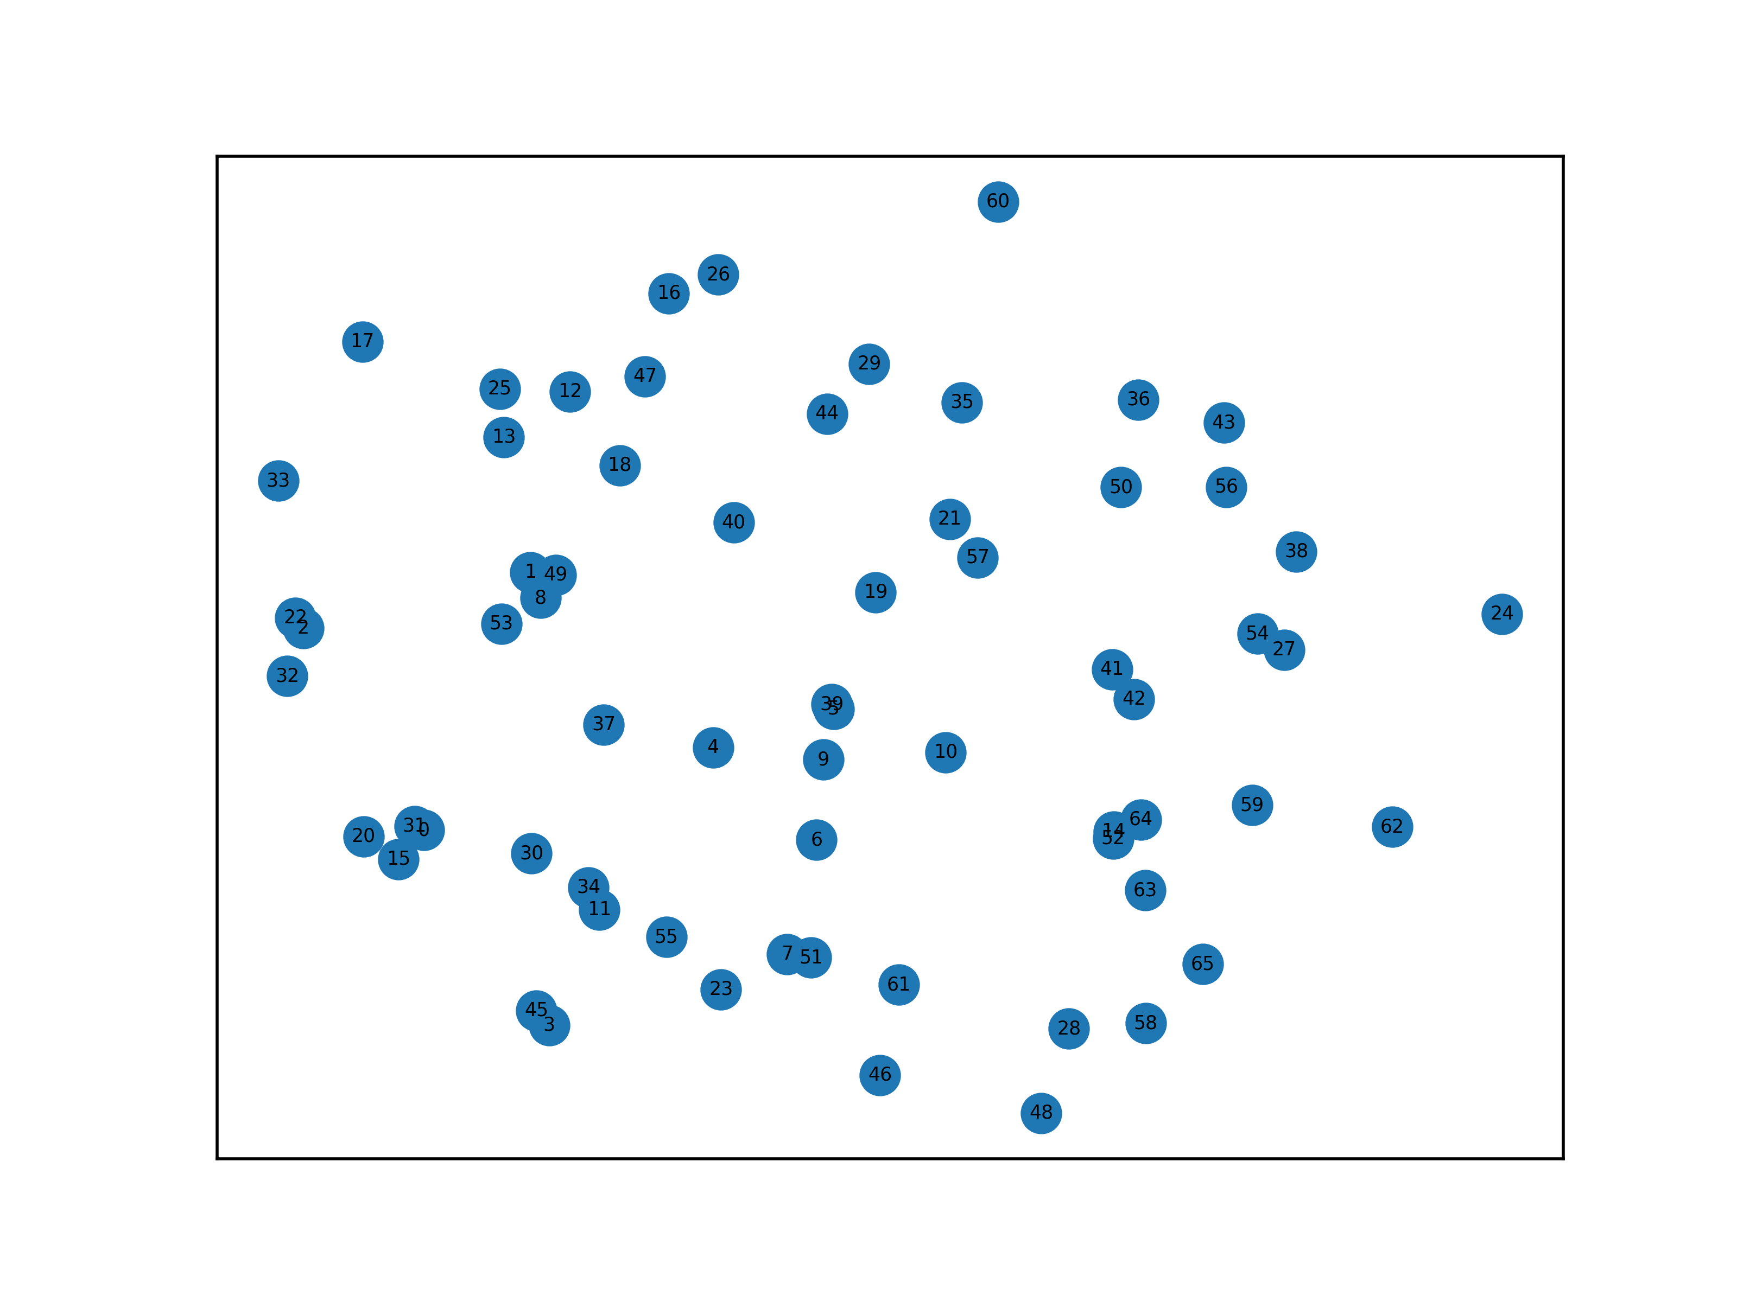
Force-directed graph
Using networkx
patient_nxgraph_spring_layout = nx.spring_layout(patient_nxgraph)

Slide 9
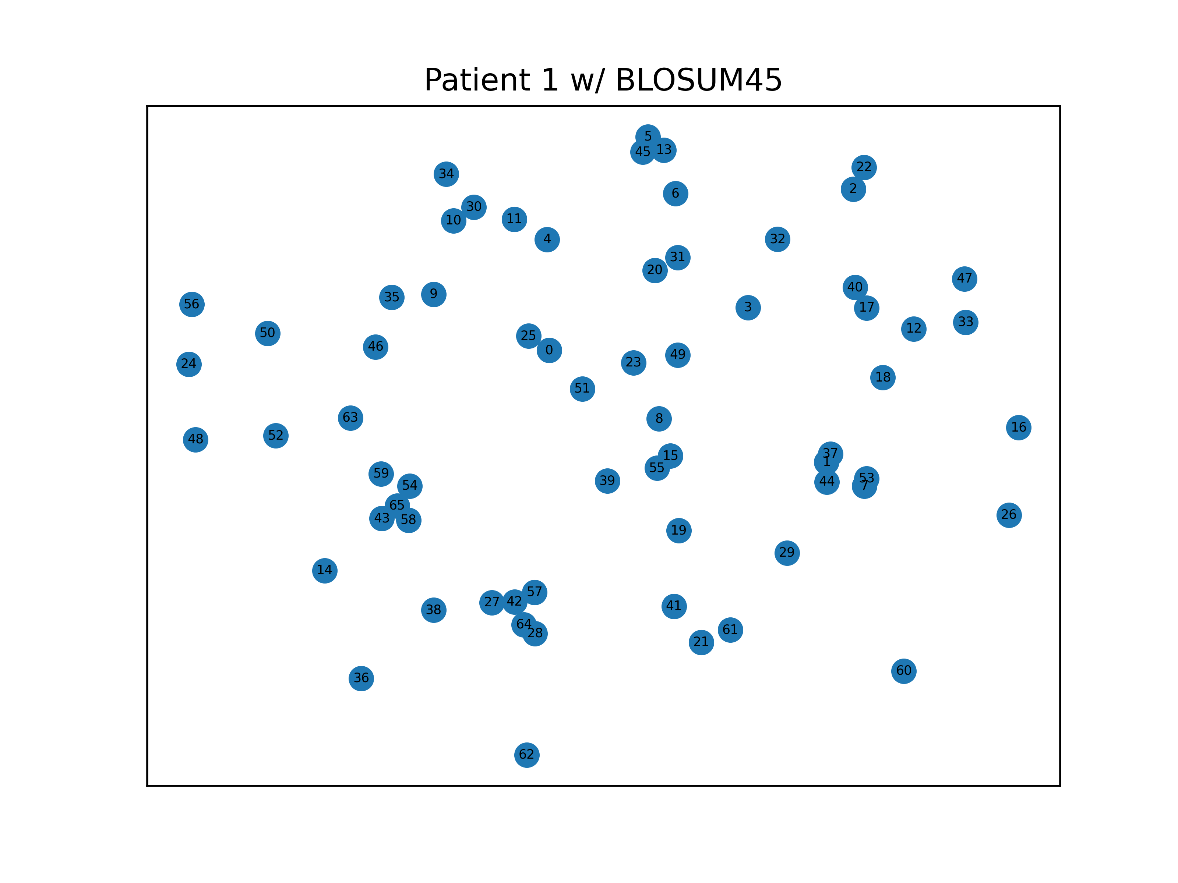
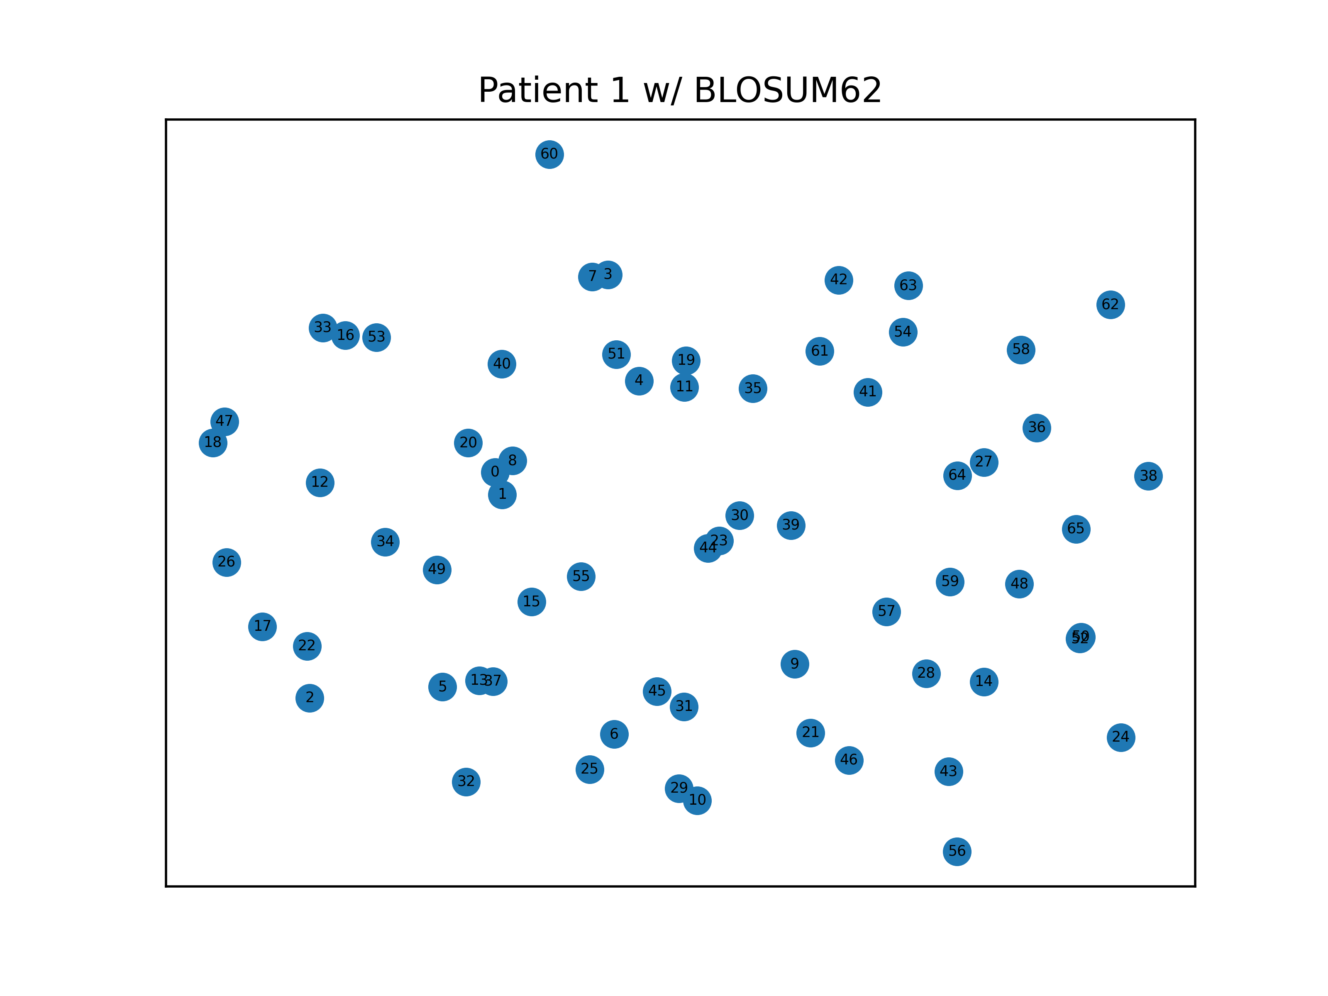
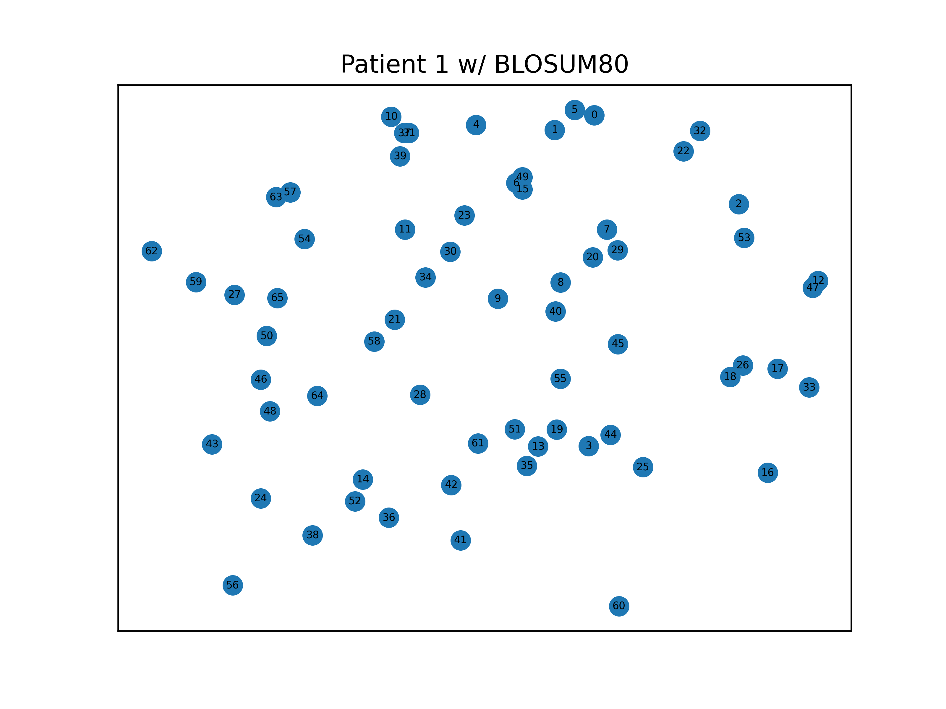
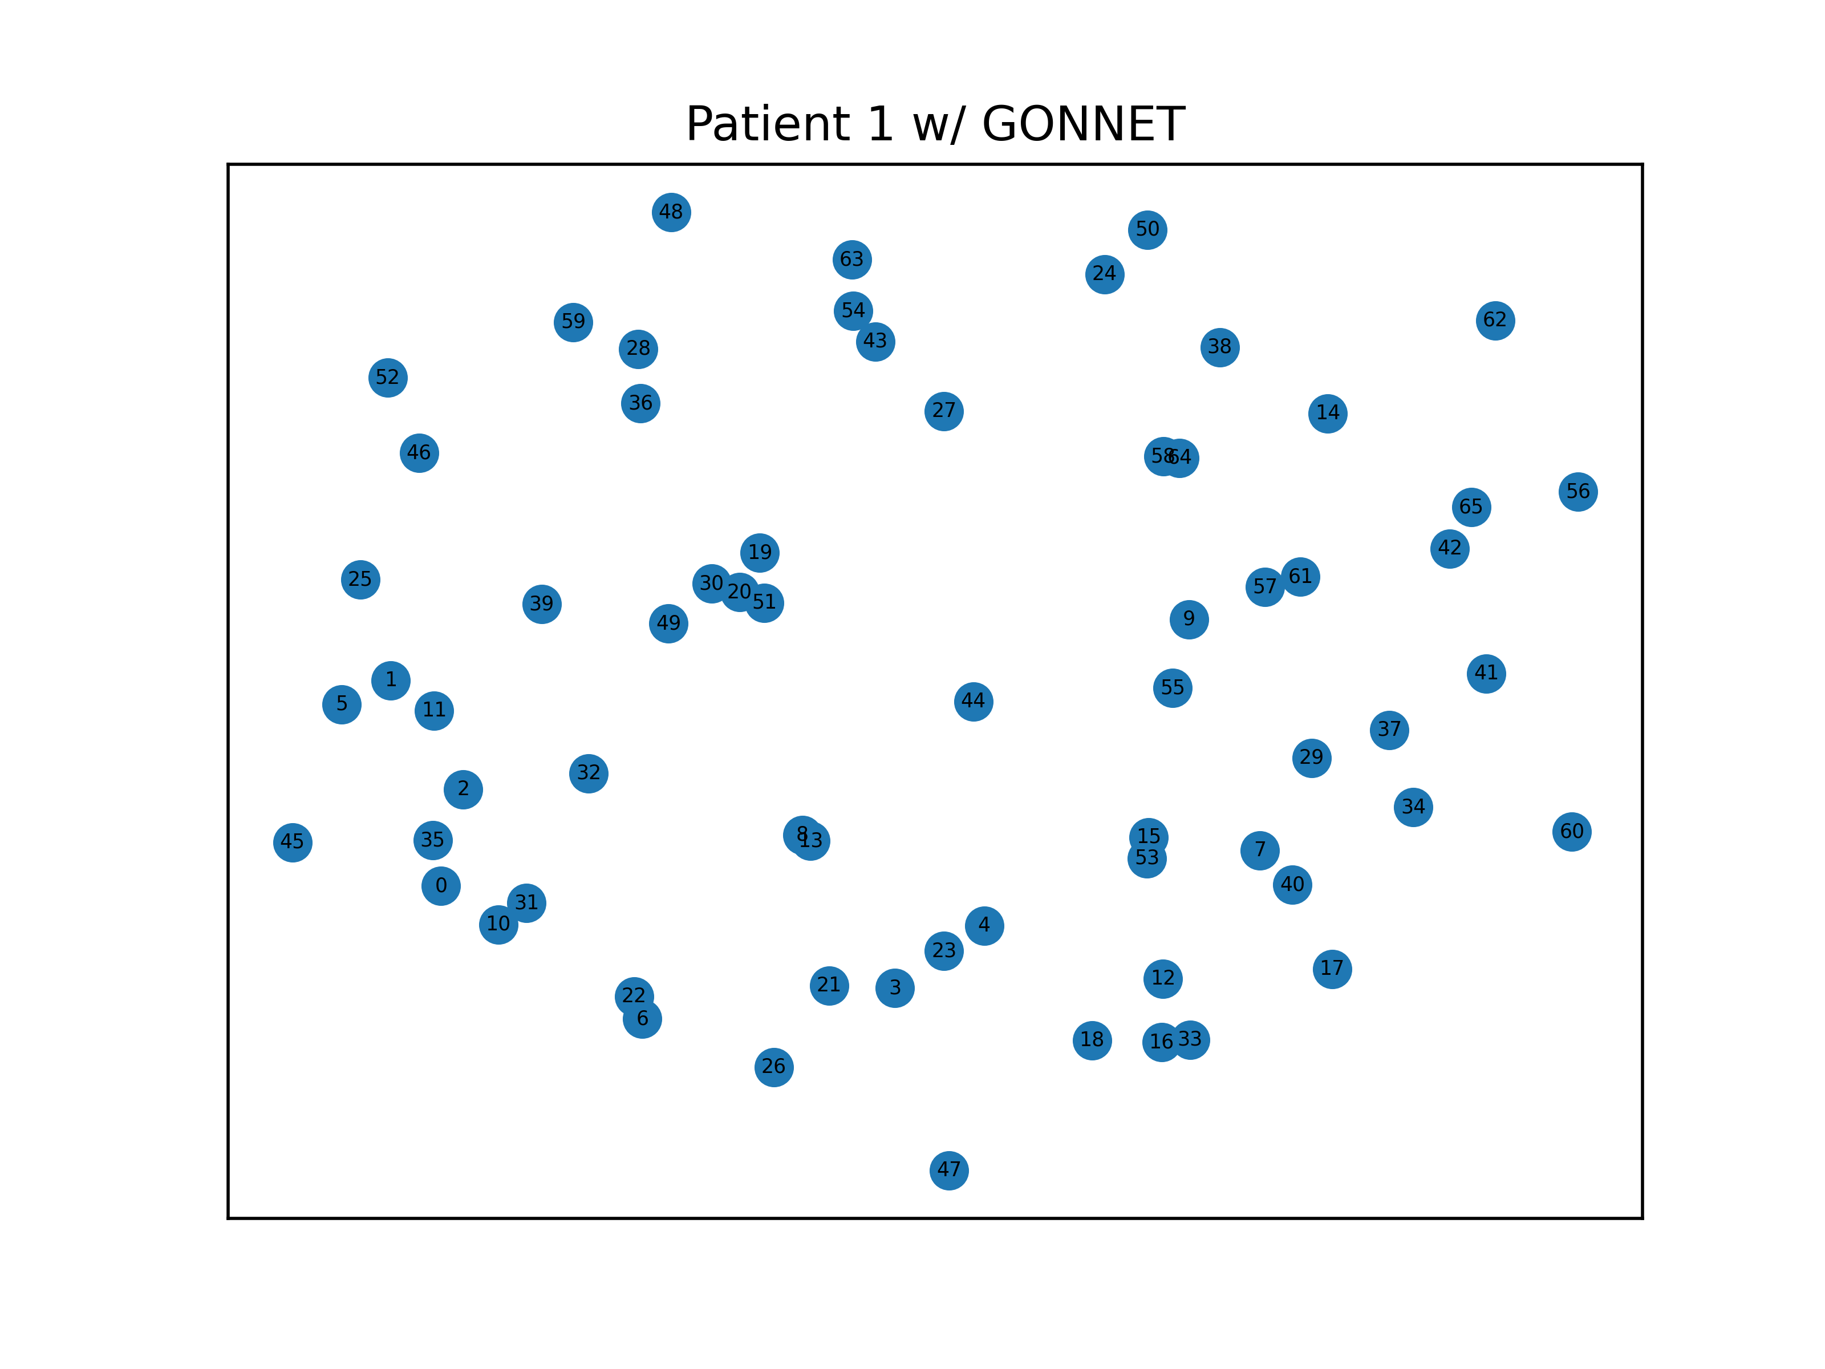
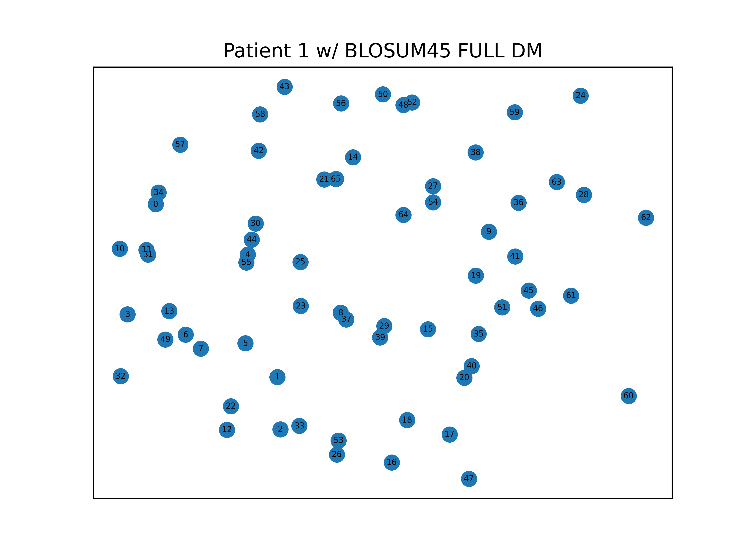
Force-directed graph P1

Slide 10
Force-directed graph P1

Slide 11
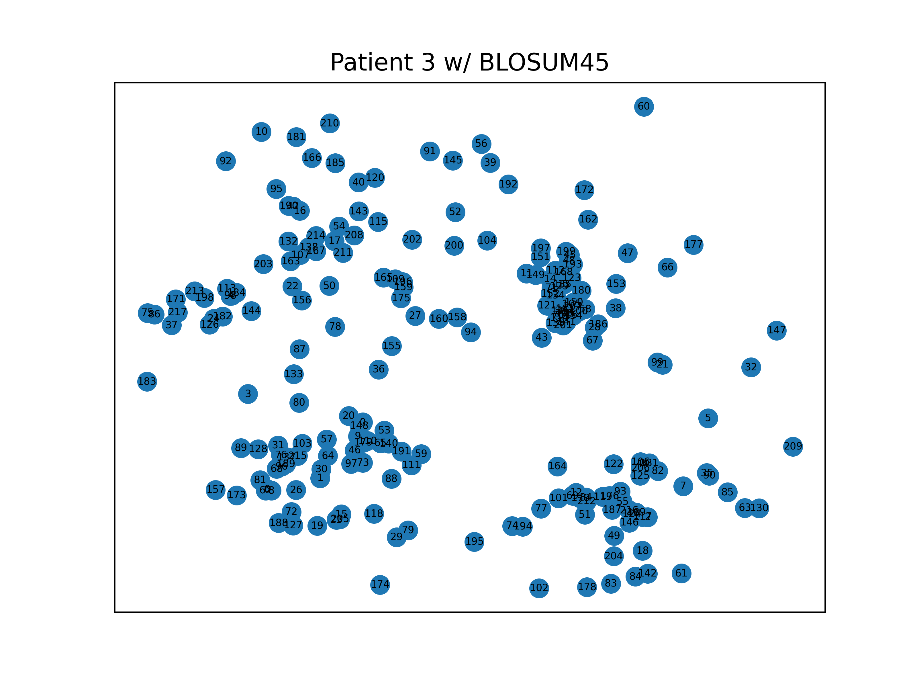
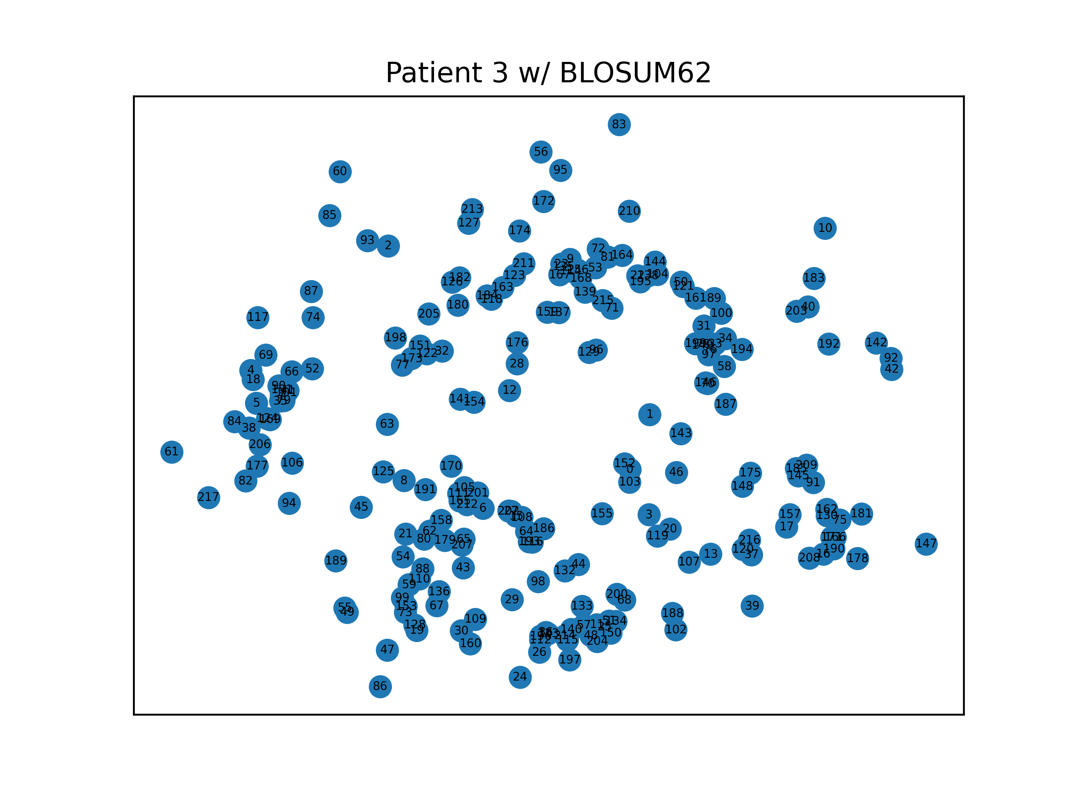
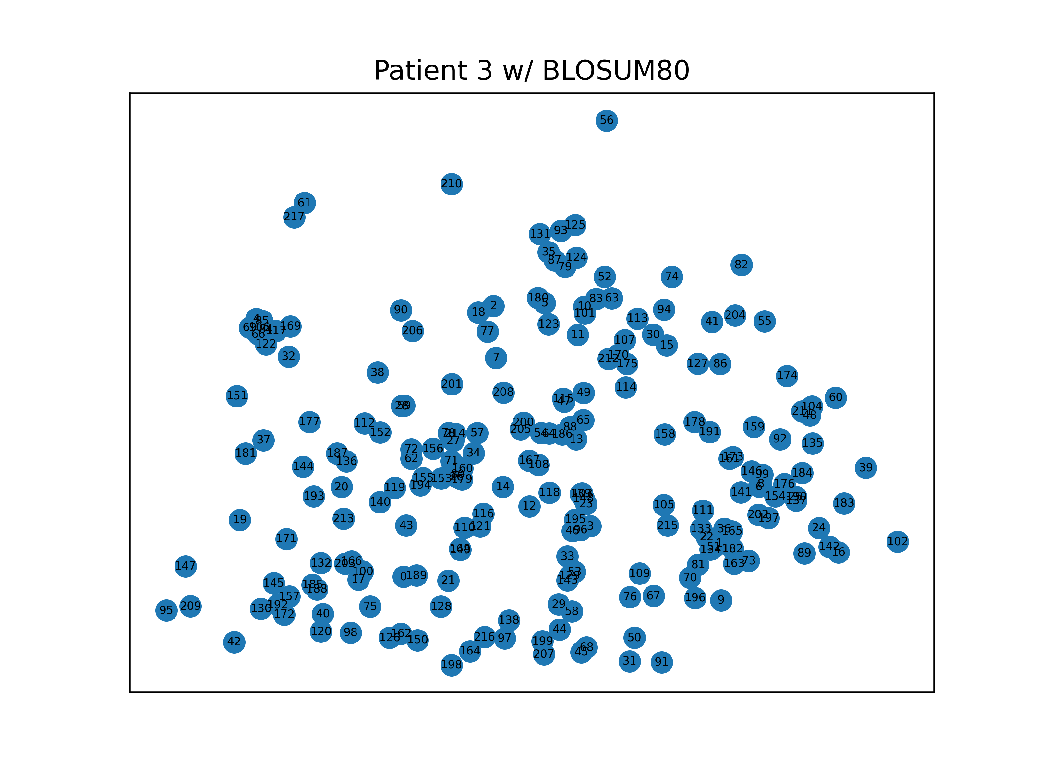
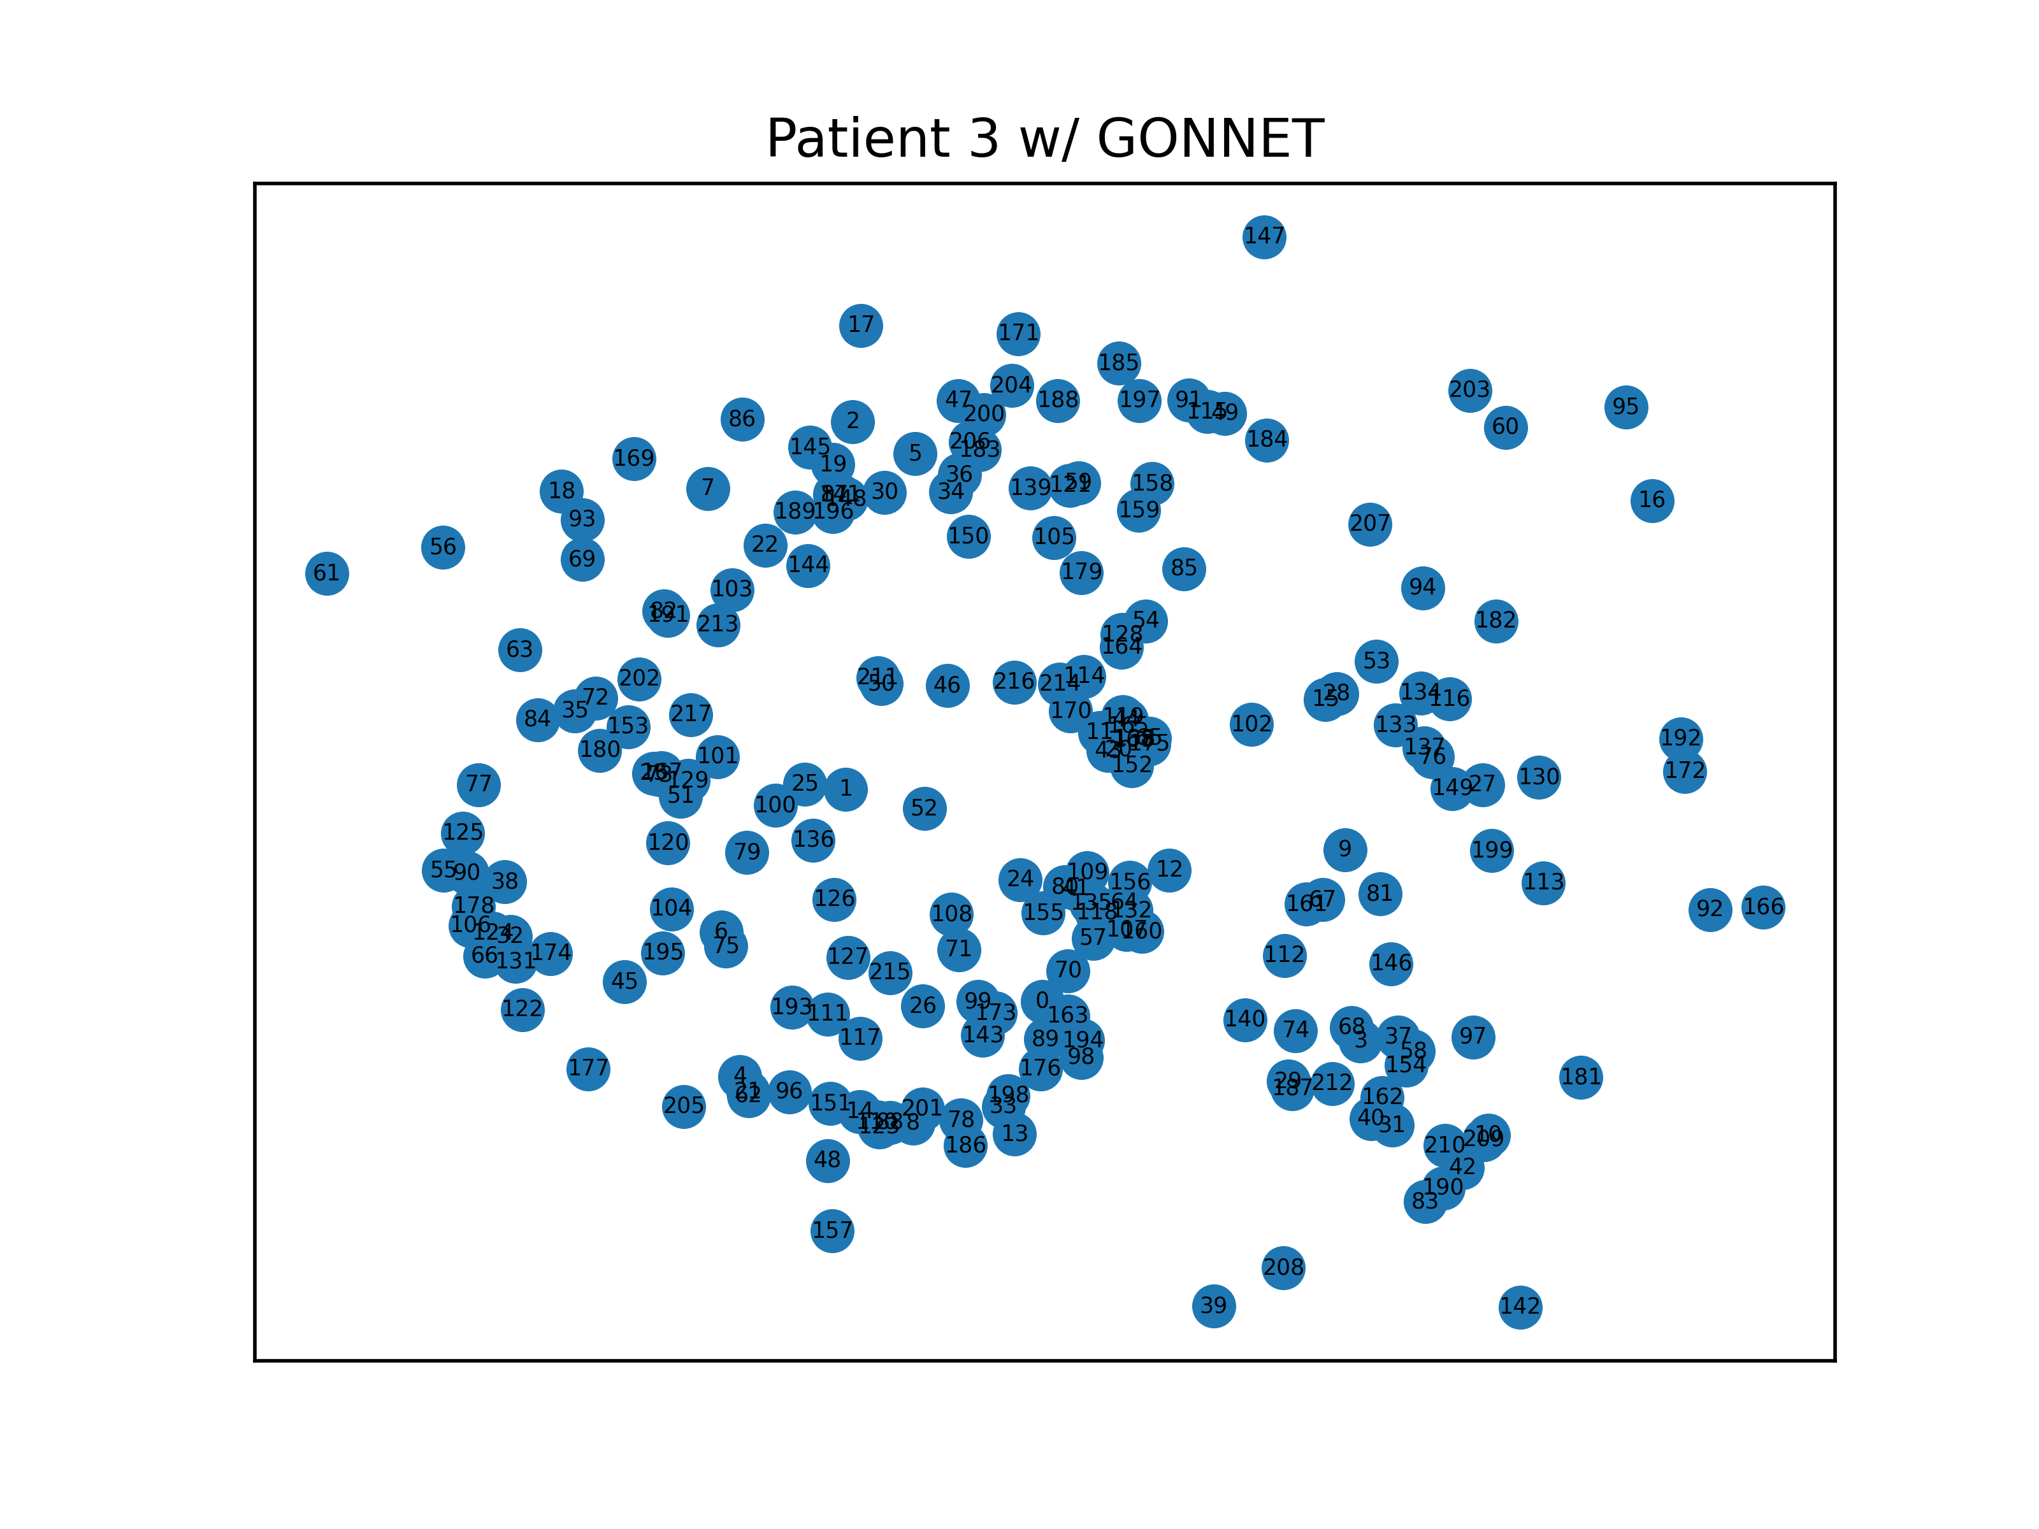
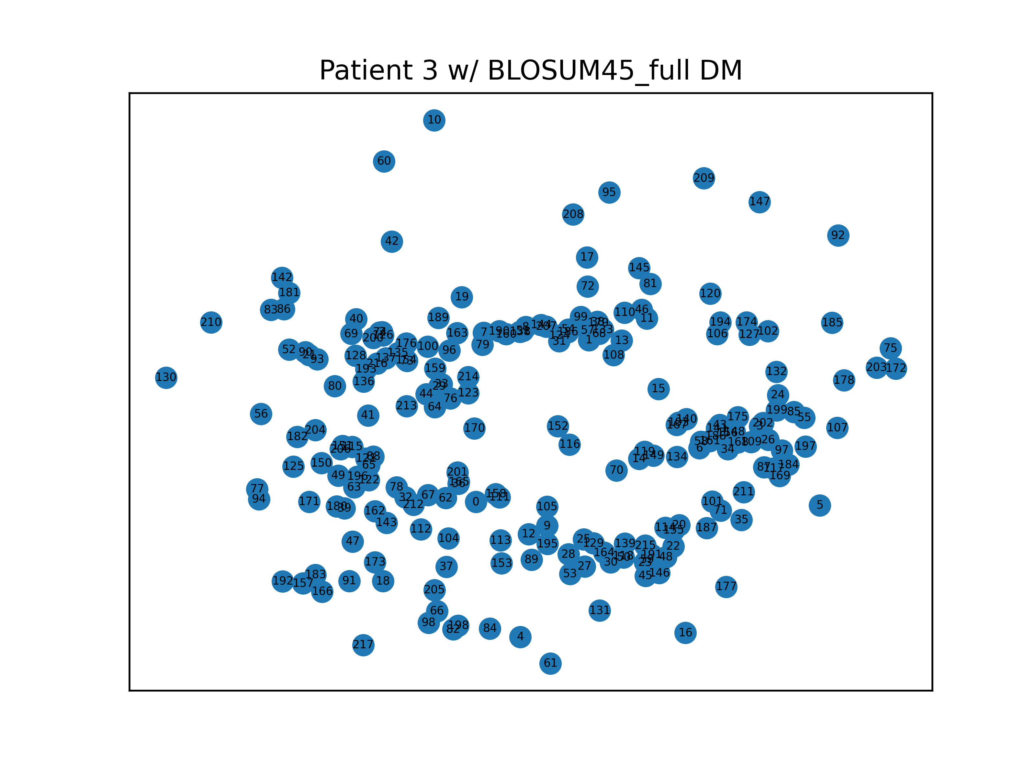
Force-directed graph P3

Slide 12
Force-directed graph P3

Slide 13
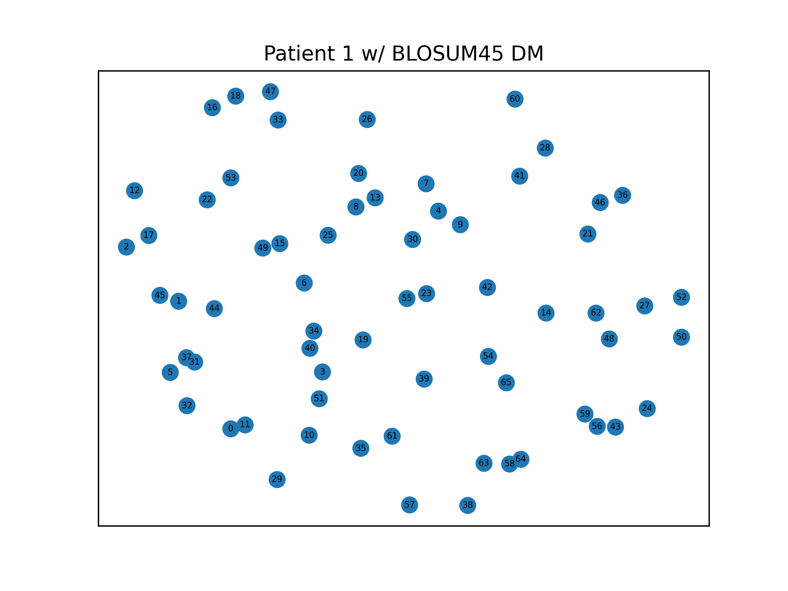
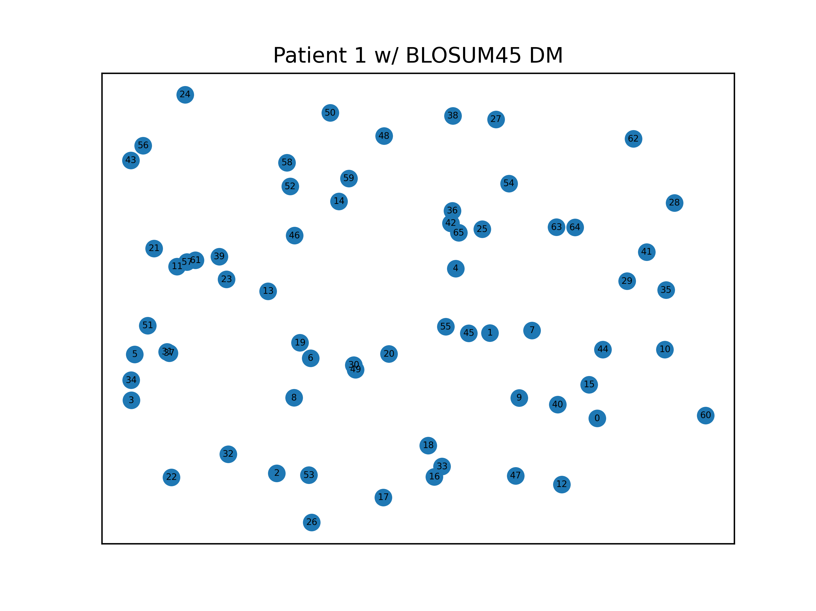
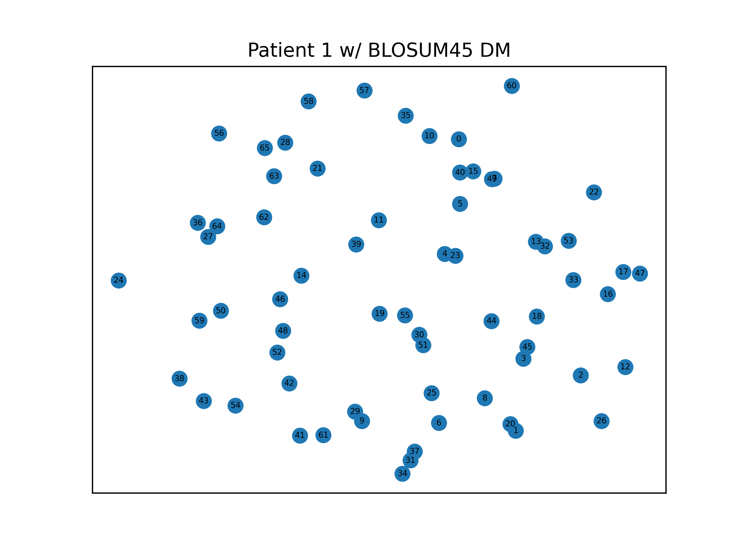

Slide 14
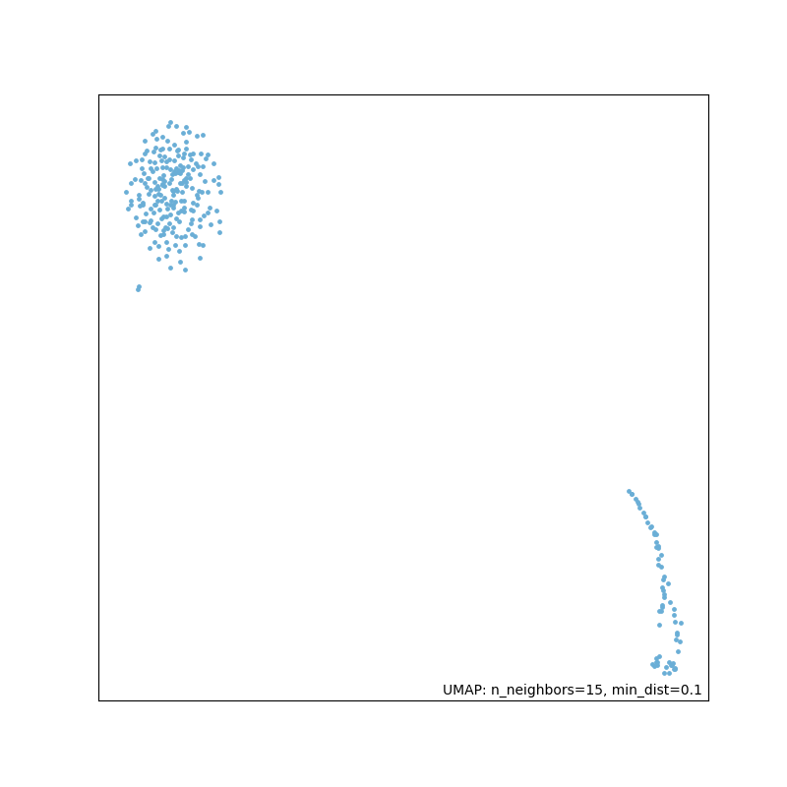
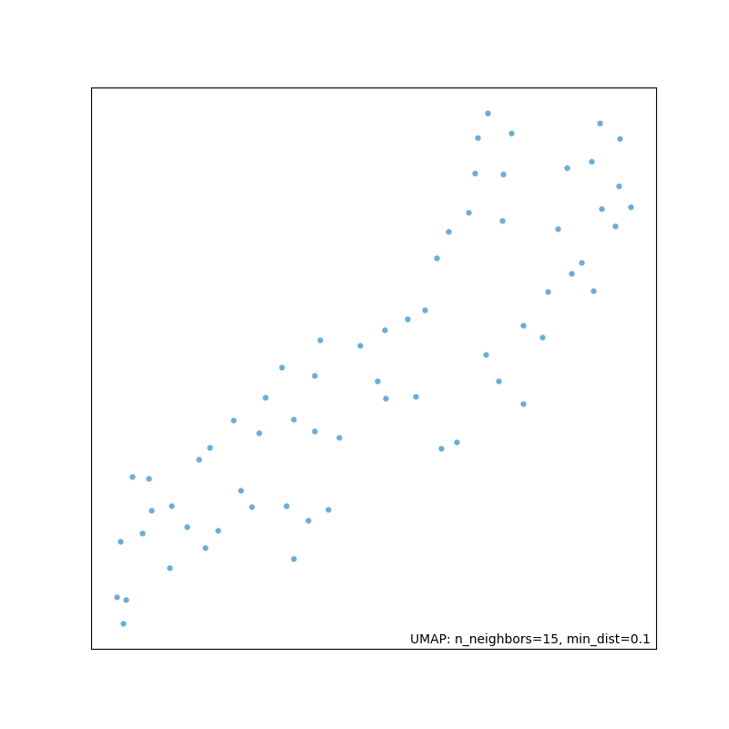
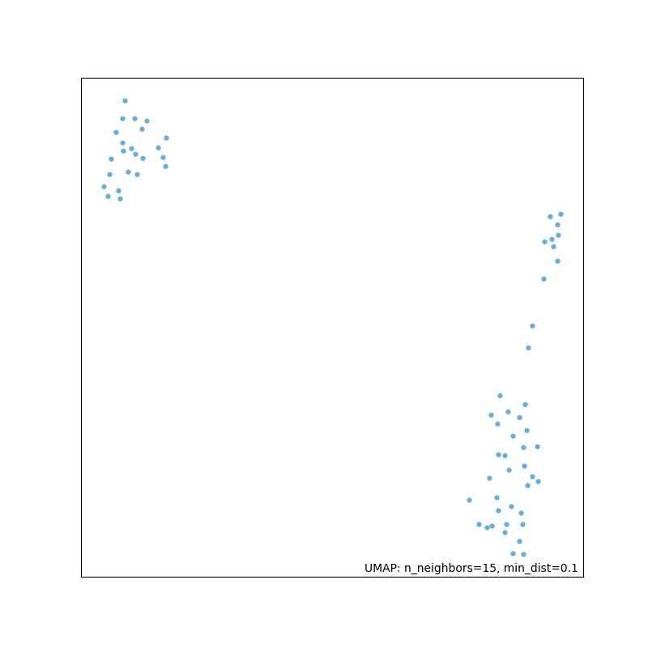
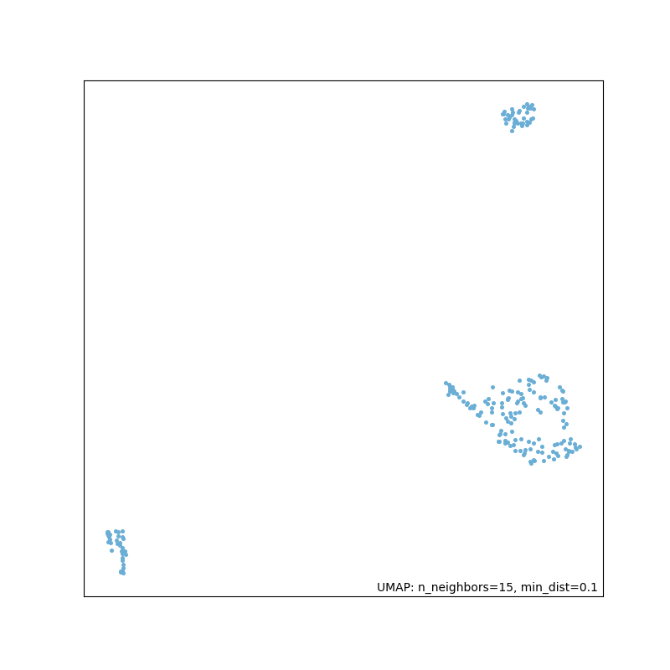
UMAP
P13B45
Using umap-leran
patient_csv_dataframe = pd.read_csv(f'P{patient_num}_DM_{substitution_matrix}{full}.csv', delimiter=',', names=[i for i in range(1, 67)]) mapper = umap.UMAP().fit(patient_csv_dataframe) plot = umap.plot.points(mapper) ^{umap.plot.show(plot)}
P1B45
P1B45 full
P13B45 full

Slide 15
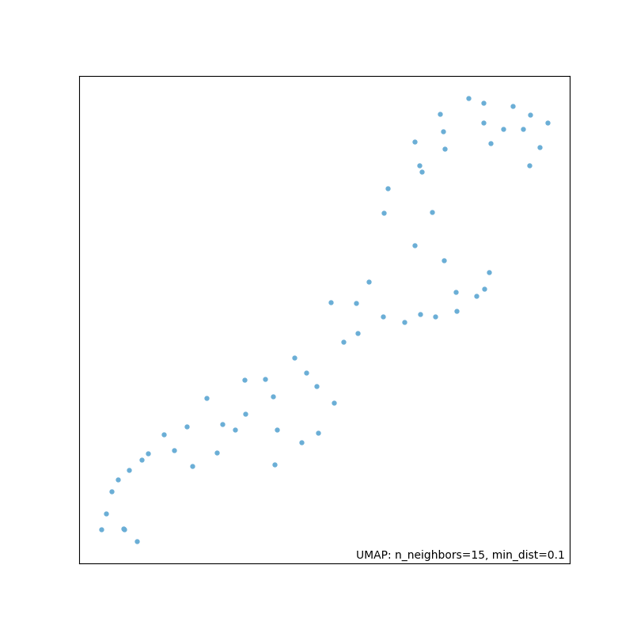
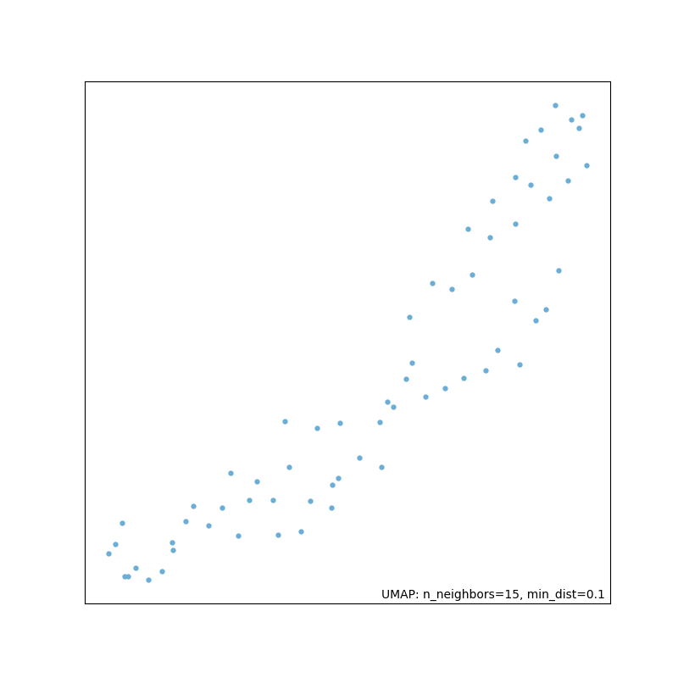
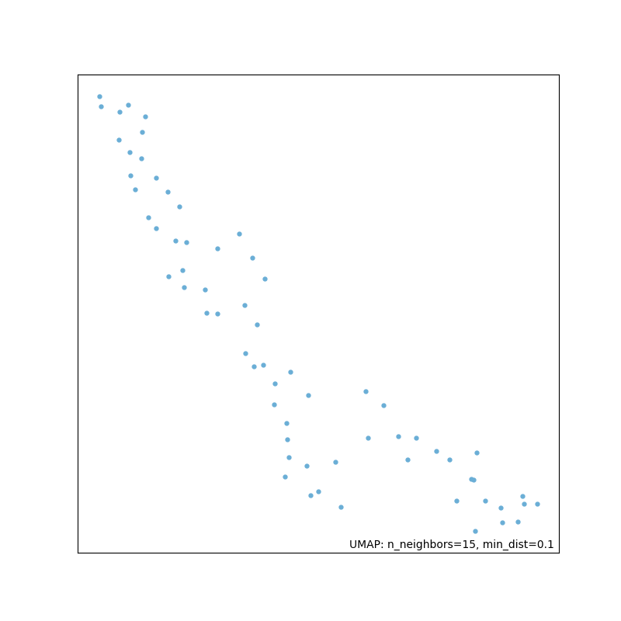
UMAP P1

Slide 16
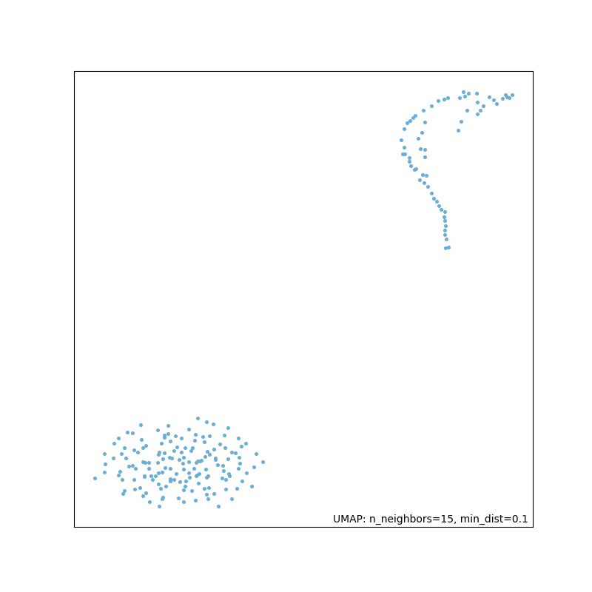
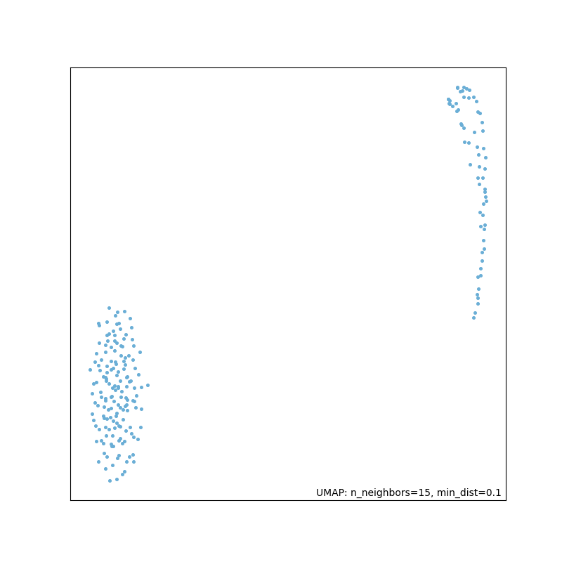
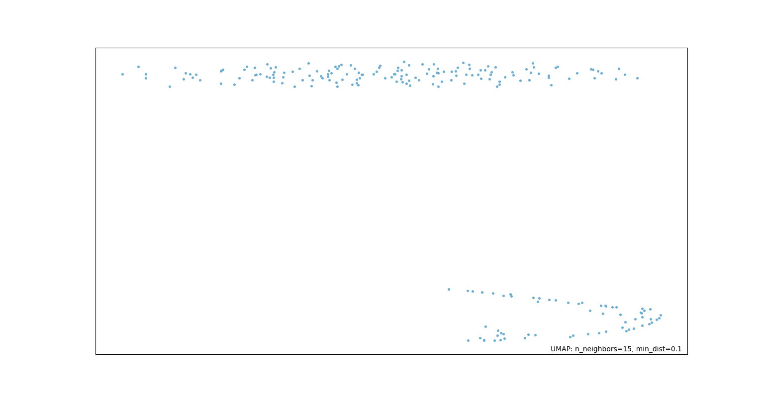
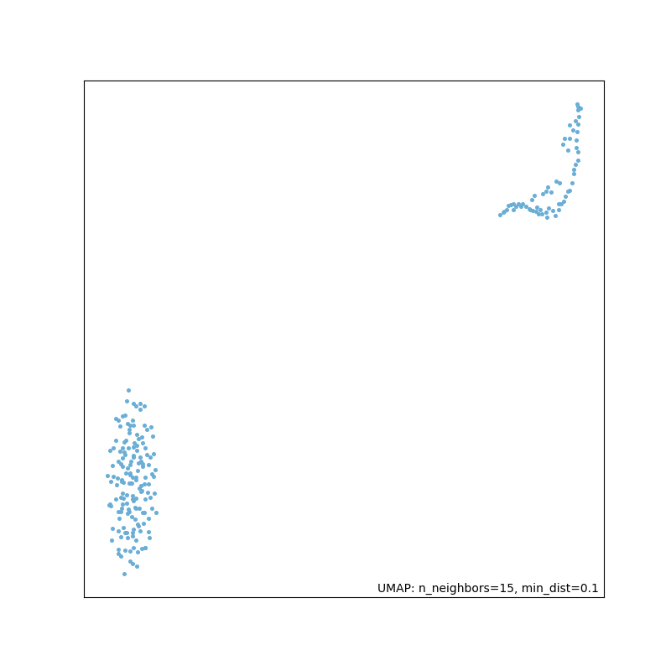
UMAP P3

Slide 17
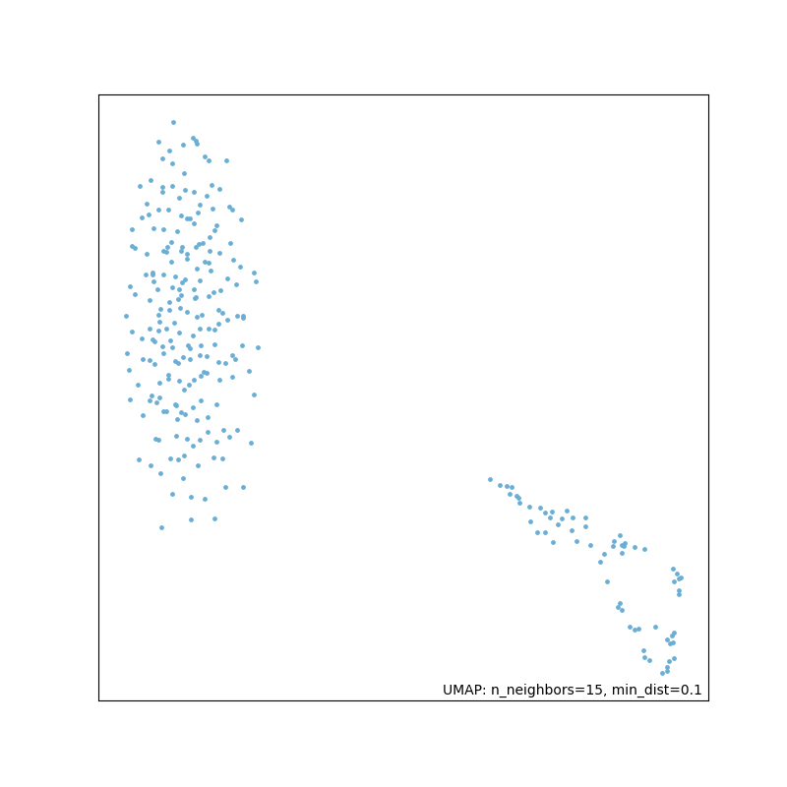
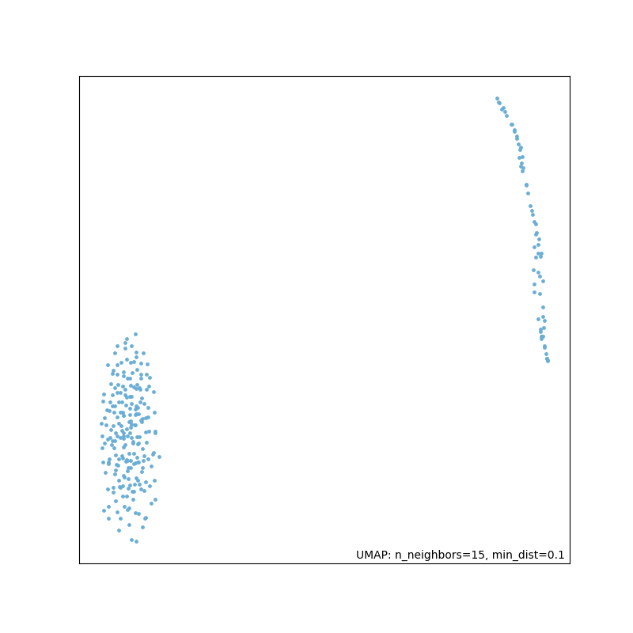
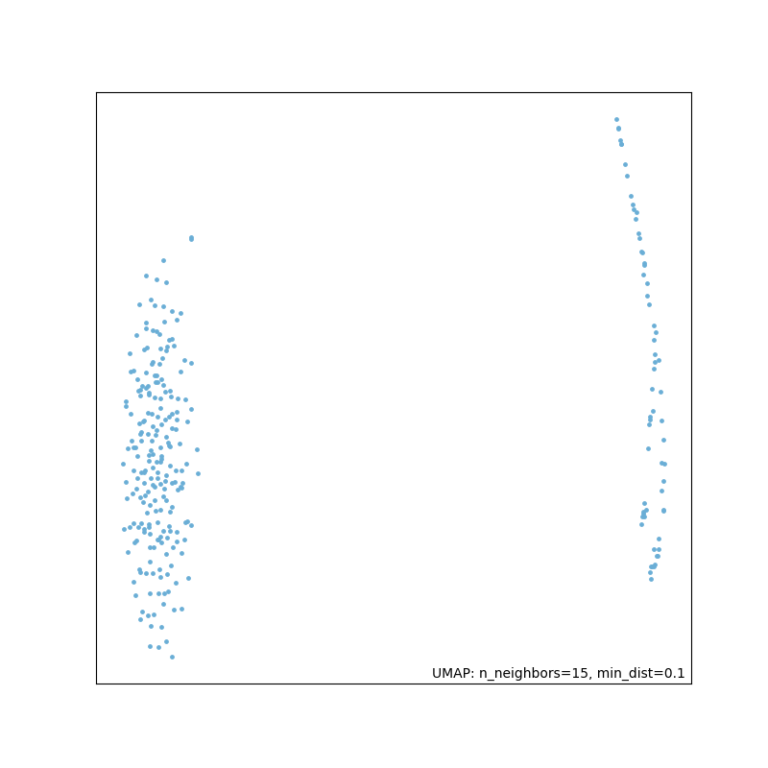
UMAP P13

Slide 18
Ausstehend
networkx: Warum sehen die Graphen aus wie sie aussehen?
UMAP: Mapping?
MSAs mit Strukturinformation, MSAs der Cluster, …

